Slide 1
Industrial Economics PPT – 17
Macroeconomic Aggregates: GDP Concepts, Economic Indicators: GDP, GNP, NNP, NDP
Methods of GDP Calculation, Problems in measuring national income, Alternative measures of Well-being

Slide 2
Learning Objectives
How to measure economic activity of a nation: GDP
The underlying idea behind GDP: Circular flow of income and expenditure
How GDP compares with other measures e.g. GVA, GNP, NNP, NDP
Alternative measures of Well-being: Human Development Index, Gross National Happiness, Green GDP
2

Slide 3
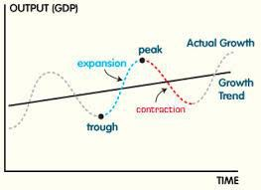
Economic Environment - nutshell graph
The graph also represents how a Business Cycle looks like
3

Slide 4
Objective 1: What is Gross Domestic Product
Gross domestic product (GDP) is the sum of the market value of all final goods and services produced within a country in a given period of time.
Market value: Used so that there are common units to add up goods and services. (INR or dollar)
Final goods and services: Only count expenditures on goods and services sold to the consumer.
Final goods vs Intermediate goods: Issue of double counting
Produced within a country: Goods and services are counted towards GDP in terms of location of production.
Given period of time: Usually refers to an annual estimate.
Annual/ Quarter (seasonally adjusted)
National Accounts Statistics produced by the National Statistical Office (NSO) of the Ministry of Statistics and Program Implementation | Government Of India (mospi.gov.in)

Slide 5
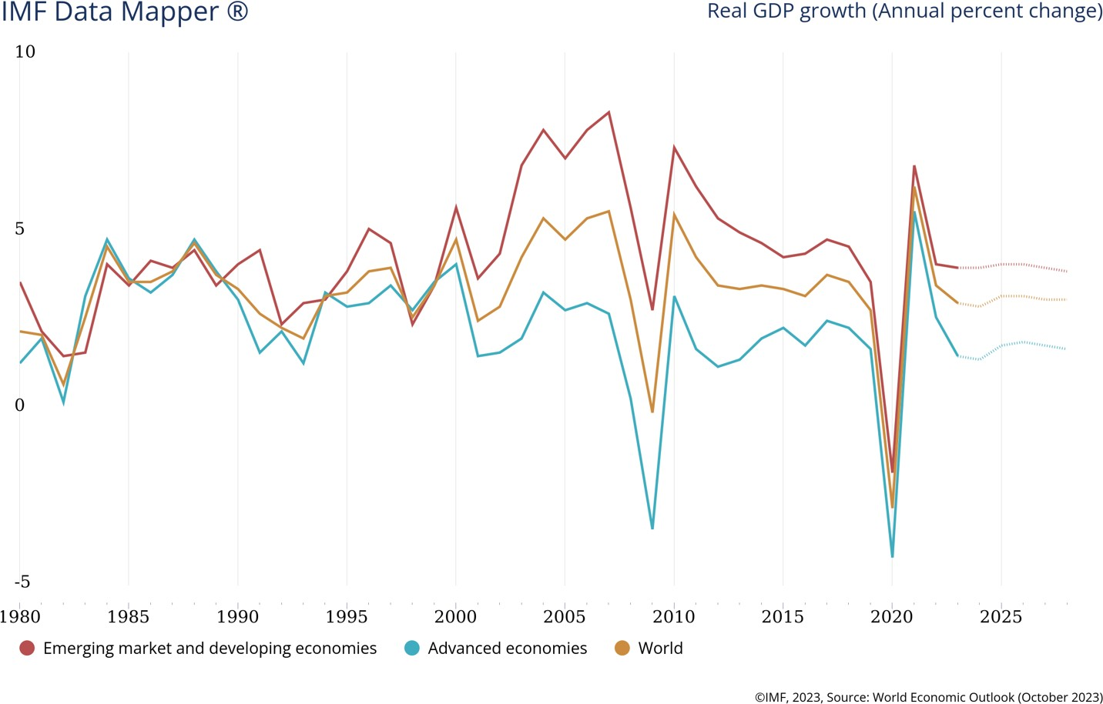
GDP growth comparison
Note: This shows the growth rate of GDP adjusted for inflation (known as Real GDP)

Slide 6
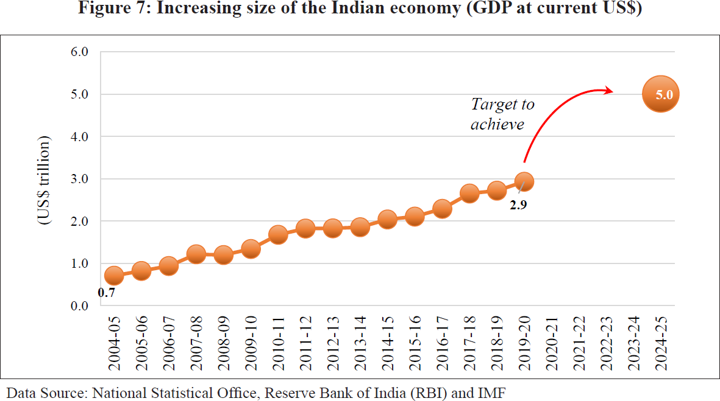
Indian GDP story

Slide 7
Objective 2: Approaches to calculate GDP
Output method ( Producers )
Output approach focuses on finding the total output of a nation. (output figures of all firms/services in the economy to get the total value of the nation’s output)
Income method ( Workers )
GDP can also be obtained by adding together the income components that make up value added.
Expenditure method ( Consumers )
If all the income generated and the output produced are to be spent and bought,
what is the total expenditure that get accounted?

Slide 8
Measuring GDP from Output (1)
GDP is value of final goods and services.
A final good is destined for final consumption.
An intermediate good is used in the production of another good.
 | Steel company | Car company
Revenue | 100 | 200
Wages | 80 | 70
Other expense 0
100 (steel purchases)
30
Profit
20
What is the GDP of this two-firm economy? ₂₀₀
Note: do not double count;
do not include sale of second hand goods
(Note: Car is final good while
steel is intermediate good)

Slide 9
Measuring GDP from Output (2)
GDP is the sum of gross value added (GVA).
Value added equals the value of a firm’s production minus
the value of the intermediate goods it uses in production.
 | Steel company | Car company
Revenue | 100 | 200
Wages | 80 | 70
Other expense 0
100 (steel purchases)
30
Profit
20
What is the GDP of this two-firm economy?
200
(note: V.A.1 is 100 + V.A.2 is 100)

Slide 10
Measuring GDP from Income
GDP is the sum of incomes.
Sum of labour income and capital income
 | Steel company | Car company
Revenue | 100 | 200
Wages | 80 | 70
Other expense 0
100 (steel purchases)
Profit
20 30
What is the GDP of this two-firm economy? 200
(note: 80+20 + 70+30)

Slide 11
A simple example for Production approach and Income approach
 | Country Wheat | Kerala Flour Ltd | Modern Bread | Total factor income
Value of Sales | 1800 | 3700 | 5400
Intermediate consumption | 0 | 1800 | 3700
Wages | 500 | 800 | 700 | 2000
Rent | 400 | 200 | 300 | 900
Interest | 600 | 400 | 300 | 1300
Profit | 300 | 500 | 400 | 1200
Total Expenditure of firm | 1800 | 3700 | 5400 | total = 5400
Intermediate goods | 0 | 1800 | 3700
Value Added | 1800 | 1900 | 1700 | =5400

Slide 12
Measuring GDP from Expenditure
GDP is the sum of spending on final goods & services.
A final good is destined for final consumption.
An intermediate good is used in the production of another good.
 | Steel company | Car company
Revenue | 100 | 200
Wages | 80 | 70
Other expense 0
100 (steel purchases)
30
Profit
20
What is the GDP of this two-firm economy?
200
(Note: Spending by the buyer
of car – the final good)

Slide 13
Measuring GDP from Expenditure
Types of expenditure in the economy:
Consumption expenditure, C
Investment expenditure, I
Government expenditure, G
Net exports, NX = eXports - iMports
An important identity for calculation of National Income:
Y = C + I + G + NX
aggregate expenditure

Slide 14
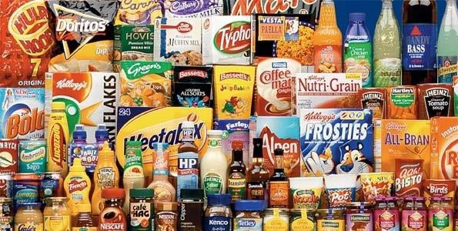
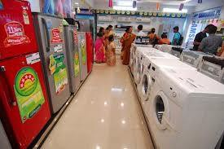
Consumption (C)
or Private Final Consumption Expenditure
Purchases of final goods and services by households. Includes:
durable goods
last a long time (>1 yr) e.g., furniture, home appliances
Non-durable goods
last a short time (<1 yr)
e.g., food, clothing
services intangible items purchased by consumers
e.g., dry cleaning, air travel

Slide 15
Investment (I)
or Gross Fixed Capital Formation
Spending on new capital goods and on net additions to inventories
Includes:
Business investment on physical capital
Spending on plant and equipment
Residential construction
Spending on new houses
Inventories
The change in the value of all firms’ inventories
Note: Investment here is not ‘financial investments’ in stocks, bonds,
FDs etc. These are considered as saving.

Slide 16
Government purchases (G)
G includes all government spending – consumption and investment
G excludes transfer payments
(e.g. subsidies, pensions, scholarships), because they do not represent spending on goods and services.

Slide 17
Net Exports (NX)
NX = eXports (X) – iMports (M)
exports: the value of goods & services sold to other countries
imports: the value of goods & services purchased from other countries
Hence, NX equals net spending from abroad on our goods & services
Also called Current Account Balance (CAB).

Slide 18
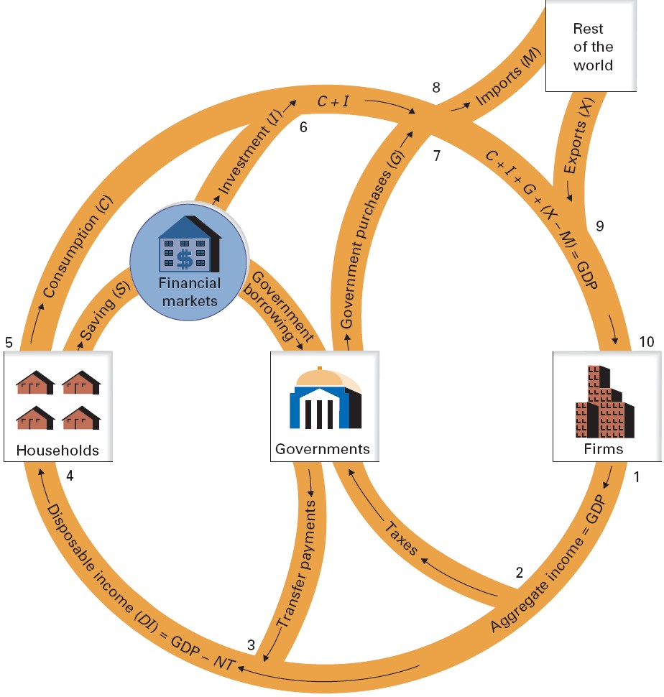
Circular flow of income and expenditure
1: GDP=aggregate income
2: Taxes leak
3: Transfer payments enter
Net taxes: NT = taxes – transfers 4: Disposable income flows to households
I
DI = aggregate income – NT
5: Households spend or save D
Consumption enters
Savings leak
6: Investment enter
7: Government purchases enter
8: Imports leak
9: Exports enter
10: Consumption + Investment +
Government purchases + Net export = Aggregate expenditure

Slide 19
Circular flow of income and expenditure
1: GDP=aggregate income
2: Taxes leak
3: Transfer payments enter
Net taxes: NT = taxes – transfers 4: Disposable Income (DI) flows to households
DI = aggregate income – NT
5: Households spend or save DI
Consumption enters
Savings leak
6: Investment enter
7: Government purchases enter
8: Imports leak
9: Exports enter
10: Consumption + Investment + Government purchases + Net export = Aggregate expenditure

Slide 20
Leakages = Injections
Equate upper & lower halves of the circular flow:
C + I + G + (X - M) = DI + NT
This can be rewritten as
C + I + G + (X - M) = C + S + NT
The equation reduces to
I + G + X = S + NT + M
This gives us an important relation:
(S - I) + (NT – G) = (X - M)
National saving-investment gap equals trade gap

Slide 21
GDP vs. GNP
Gross domestic product (GDP):
Total income earned by domestically-located factors of production, regardless of nationality
Gross national product (GNP):
Total income earned by the nation’s factors of production,
regardless of where it is located
GNP – GDP = factor income from abroad
minus factor income to abroad
Examples of factor income: wages, profits, rent, interest & dividends

Slide 22

Discussion Question
Which would you want to be bigger, GDP or GNP?
Why?
22

Slide 23
GNP vs. GDP in select countries, 2010
Country | GNP | GDP | GNP – GDP (% of GDP)
Bangladesh | 109,695 | 100,357 | 9.3
Japan | 5,601,557 | 5,458,837 | 2.6
China | 5,957,012 | 5,926,612 | 0.5
United States | 14,635,600 | 14,586,736 | 0.3
India | 1,712,645 | 1,727,111 | -0.8
Canada | 1,549,652 | 1,577,040 | -1.7
Greece | 292,874 | 301,083 | -2.7
Iraq | 77,842 | 82,150 | -5.2
Ireland | 171,260 | 206,612 | -17.1
GNP and GDP in millions of current U.S. dollars

Slide 24
Market Prices vs. Basic Prices vs. Factor Cost
Previously India measured GDP at factor cost
GDP at factor cost + (Indirect taxes less subsidies) = GDP at market prices
From 2014-15, India shifted from factor cost to basic prices in the way GDP is measured and started using GVA to measure GDP
GDP at factor cost + (Production taxes less Production subsidies) = GVA at basic prices
GVA at basic prices + (Product taxes- Production subsidies) = GDP at market prices
Production taxes/ subsidies are independent of volume of production
The new methodology follows the UN’s System of National Accounts
(SNA, 2008)

Slide 25
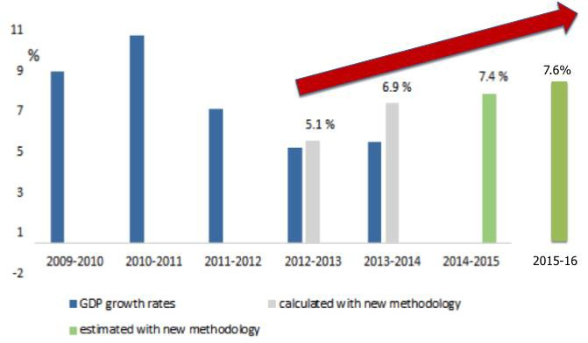
Revision in GDP methodology
Other changes in the GDP calculation:
Wider coverage
Change in base year
from 2004-05 to 2011-12
Chief Statistician TCA Anant on the change in GDP calculation:
https://www.youtube.c om/watch?v=oGhW5Ha 15OE

Slide 26
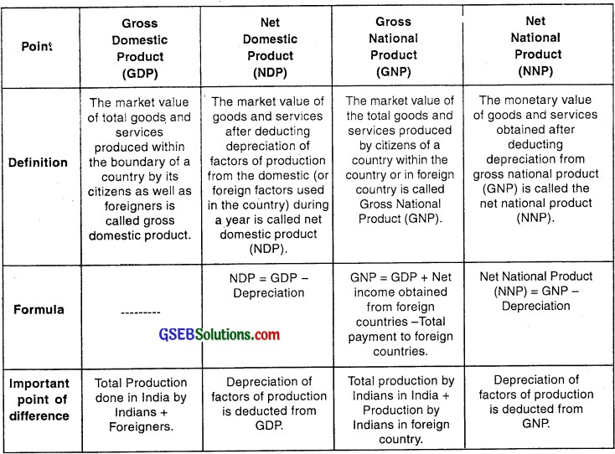
Macroeconomic Aggregates - Concepts

Slide 27
Is GDP a Good Measure of Economic Health?

Slide 28
What is GDP?
Gross domestic product (GDP) is the monetary, market value of all final goods and services produced in a country over a period of a year.
The real GDP per capita (corrected for inflation) is generally used as the core indicator in judging the position of the economy of a country over time or relative to that of other countries.
The GDP is thus implicitly, and often even explicitly, identified with social welfare - ‘standard of living’.
This approach does not follow from any theory about GDP as a measure of social welfare, but has grown to become like this in the course of time.

Slide 29
Limitations of GDP
Formal vs Informal Economy
GDP does not factor in the value of informal activities and services leading to under-estimation
A large chunk of GDP growth comes from transfer of existing informal activities to a formal market

Slide 30
Limitations of GDP
Underground Economic Activity
Real GDP, as measured, omits the underground economy, which is illegal economic activity or legal economic activity that goes
unreported for tax avoidance reasons.
For example,
production and distribution of illegal drugs,
production that uses illegal labor
jobs done for cash to avoid paying income of taxes.

Slide 31
Limitations of GDP
Environmental externalities and depletion of resources
GDP does not factor in the external costs incurred during production, such as pollution and depletion of resources
This leads to over-estimation of actual wealth by GDP

Slide 32
Limitations of GDP
Income distribution, relative income and rivalry for status
Neglects the income distribution
Diminishing marginal utility
Omits the relative income aspect of welfare
Does not talk about the status

Slide 33
Other issues…
Household production is not accounted for in GDP
Health and life expectancy are not directly included in GDP
Political freedom and social justice are not included in GDP
GDP estimates have a lag time. It does reflect real time decisions
“Our gross national product…counts air pollution and cigarette advertising and ambulances to clear our highways of carnage. It counts special locks for our doors and the jails for the people who break them. It counts the destruction of the redwood and the loss of our natural
wonder in chaotic sprawl.…Yet the gross national product does not allow for the health of our children, the quality of their education, or the joy of their play”
- Robert F Kennedy

Slide 34
Alternatives to GDP: Measures of Well-being
Changes desirable in existing methodology:
- Should include factors like owner occupied housing, state run healthcare and education, unpaid child care by parents
- concentrate on households' incomes, consumption and wealth rather than total production
Sizing up the Good life – “Quality of Life”
- 'Ladder of Life’ Scores
Well-Being of Future Generations
- Passing on existing resources to the next gen
- Future human skills depend on investment in education and research today

Slide 35

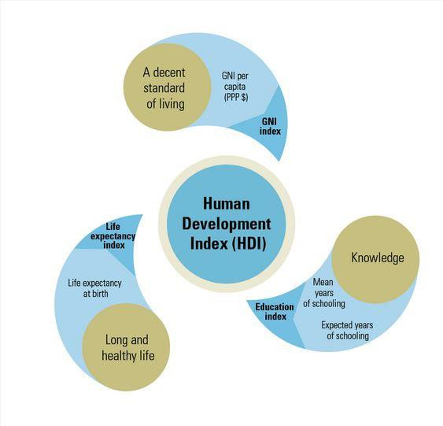
Human Development Index
The HDI consists
of three aspects of
development:
1) “A long and healthy life” (Health)
Measured by life expectancy at birth
2) “Knowledge” (Education)
Measured as a combination of literacy (with two-thirds weight) and enrollment (with one-third weight)
3) “A decent standard of living” (Wealth)
adult
gross
HDI is expressed as a value between 0 and 1. The closer to 1 the score is, the higher level of human development. HDI covers 188 countries.

Slide 36
Gross National Happiness
In
1972, the Fourth Dragon King of Bhutan, Jigme Singye Wangchuck, made a
revolutionary statement: “Gross National Happiness is more important than Gross National Product.”
The index relies on four pillars: good governance, sustainable socio-economic development, cultural preservation, and economic conservation. These have recently been expanded into nine domains that contribute to the aggregation of happiness: psychological well-being, health, education, time use, cultural diversity and resilience, good governance, community vitality, ecological diversity and resilience, and living standards
This declaration sparked a change—not just in Bhutan, but globally. The Bhutanese government believes that the Gross National Happiness (“GNH”) index more accurately and profoundly reports the overall well being of the nation than other methods

Slide 37
Green GDP
The green gross domestic product (green GDP or GGDP) is an index of economic growth with the environmental consequences of that growth factored into a country's conventional GDP. Green GDP monetizes the loss of biodiversity, and accounts for costs caused by climate change.
Indicative of sustainable development
Identifies wealth and assets that underlie the
observable growth
Why GGDP ?
Accounts for permanent or significant
depletion or replenishment of these assets
Takes into account the positive and negative
externalities of environmental components

Slide 38
The trouble with GDP
Source: https://www.economist.com/briefing/2016/04/30/the-trouble-with-gdp
Discussion questions:
Does GDP measure what it is supposed to?
How can we improve GDP measurement?

Slide 39
GDP vs. GDP per capita vs. GDP (PPP)
https://en.wikipedia.org/wiki/List_of_countries_by_GDP_(nominal)
https://en.wikipedia.org/wiki/List_of_countries_by_GDP_(nominal)_ per_capita
https://en.wikipedia.org/wiki/List_of_countries_by_GDP_(PPP)

Slide 40
Raghuram Rajan says India needs to grow at 8% to create enough jobs to meet demand: Report
https://www.businesstoday.in/latest/economy/story/raghuram-rajan-says-india-needs-to-grow-at-8-to-create-enough-jobs-to-meet-demand-report-405444-2023-11-11

Slide 41
Next…
Unemployment and Inflation
How is inflation measured?
Why do we have inflation?
How is unemployment measured?
Why do we have unemployment?

